Slide 1
Reading old Script from Norwegian Records Practicum 6December2025 Updated 11/30/2025 2:09 PM

Slide 2
We’ll look at old documents and figure out what they are and what they say . . .
Please ask questions as we go – I’ll either answer or defer if the subject comes up later.
Previous documentation and talk is attached to the Power Point – refer to it at your leisure.
Have fun . . .

Slide 3
1841 What is it. Find Martha Hansdatter
1820 What is it. Find Anne Larsdatter
1768 What is it. Find Peder Andersen
1861 What is it. Find Sivert Knudsen
1787 What is it. Find Hemming Larsen
1828 What is it. Find Peder Andersen
1783 What is it. Find Berte Erichsdatter
1851 What is it. Find Anne Larsdatter
1806 What is it. Find Arne Larsen
1771 What is it. Find Mons Eriksen
1696 What is it. Find Marie Bendeke
1857 St. Louis USA – What is it. Who did it.

Slide 4
1841 What is it. Find Martha Hansdatter
Birth Martha Hansdatter 1841.pdf
1820 What is it. Find Anne Larsdatter
Birth Anne Larsdatter 1820.pdf
1768 What is it. Find Peder Andersen
Birth Peder Andersen 1768.pdf
1861 What is it. Find Sivert Knudsen
Confirmation Sivert Knudsen 1861.pdf
1787 What is it. Find Hemming Larsen
Confirmation Hemming Larsen 1787.pdf
1828 What is it. Find Peder Andersen
Death Peder Andersen 1828.pdf
1783 What is it. Find Berte Erichsdatter
Death Berte Erichsdatter 1783.pdf
1851 What is it. Find Anne Larsdatter
Marriage Anders Bentsen and Anne Larsdatter 1851.pdf
1806 What is it. Find Arne Larsen
Marriage Arne Larsen Inger Mortensdatter 1806.pdf
1771 What is it. Find Mons Eriksen
Marriage Mons Eriksen Brita Christoffersdatter 1771.pdf
1696 What is it. Find Marie Bendeke
Marriage Ole Jensen Holter and Marie Bendeke Jochumsdatter 1696.pdf
1857 St. Louis USA – What is it. Who did it.
Marriage Certificate Joseph Flottemesch Catharine Marie Anna Wormann 1857.pdf

Slide 5
The slides below refer to a Jonny Lyngstad talk and slides which were developed from Knut Johannessen’s book, “Dem glemte skriften Gotisk håndskrift I Norge” which can be bought used from Norway sites. It is available – using a Norwegian VPN – online at http://nb.no.
Information is used with permission.

Slide 6
For most Norwegian records, you need to be able to recognize a few key words or phrases and be able to read the names.
We’re covering Baptism, Marriage, and Death records. If we get time, we’ll touch on Confirmation records
Most census records are indexed only and so we don’t need to cover those.
Other records – probate, tax, military, and the like are more intensive and won’t be covered. But the techniques work.

Slide 7
To find your relatives in the records, you must know the format and what a few key words – and their abbreviations look like.
You must also be able to read names – which requires a recognition of the format of the record to locate them and the ability to see abbreviated names.
I’ve attached a PDF which contains the heading illustrated as they are too small to read.
We’ll work through some document types and practice with examples.
Note that – as the documents get older, all headings and organization go away.

Slide 8
Baptisms generally follow the same format for most eras.
Earlier baptisms are usually separated – one page for males and one for females – or even a whole section for each sex.
The earliest baptisms were intermingled with other types of church events, but the information recorded remained consistent.
In some parishes, the earliest baptisms do not list the mother.

Slide 9
The year and date are listed for baptisms, but earlier baptisms may have that as a ecclesiastical date and the baptism record may be in a section for a particular Sunday – with the date above for all things that happened that Sunday.
Birth dates were not originally kept but bny the 1820’s most baptism records record both the baptism and the birth date.

Slide 10
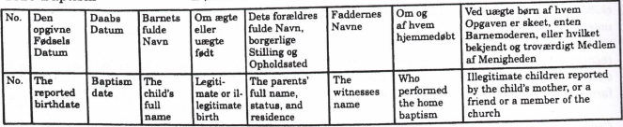
The general format is shown below.
But remember, as you go earlier, not all columns are included.
Also, as you go earlier, often the father’s and maybe the mothers name will be first.
If you are lucky, the baptized name will be underlined.

Slide 11


In most cases where columns are not used, the Father’s name will come first. Sometimes it will start with the Father’s and the Mother’s names, and even their residence and/or occupation.
The key words to look for - Døbte (baptized) or Fødte (born) indicate a baptism.
In most cases where columns are not used, you
will want to find “B:” or a “nom:”.
This will precede the baptized first name.
The last name will be the father’s first name
followed by sen or datter.
The last name will be the father’s first name followed by sen or datter.

Slide 12
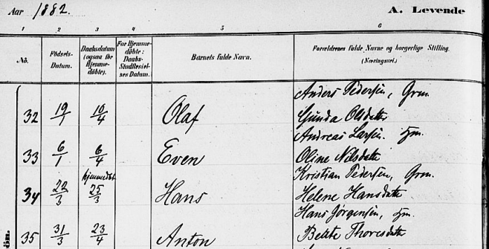
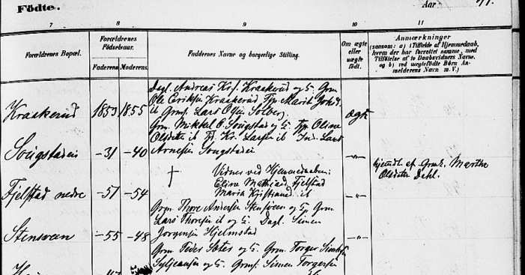
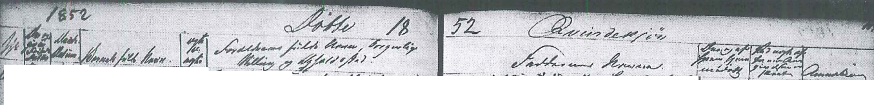
Examples – Anton Hanssen, 1882 Link
Example – Maria Jensdatter 1852 Link
Notes:
URN:NBN:no-a1450-kb20070110660397.jpg (1954×1536) (digitalarkivet.no)
URN:NBN:no-a1450-kb20070119310111.jpg

Slide 13
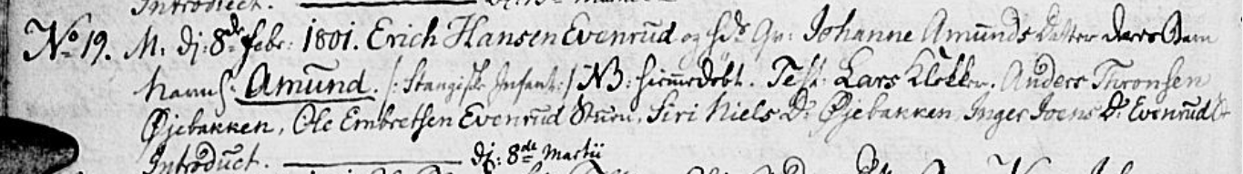
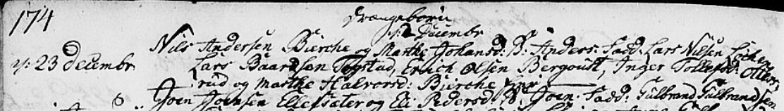
Example - Amund Eriksen 1801 Link
Example – Anders Nilson 1787 Link
Notes:
URN:NBN:no-a1450-kb20070513090130.jpg (1984×1536) (digitalarkivet.no)
URN:NBN:no-a1450-kb20070512950185.jpg (2048×1497) (digitalarkivet.no)

Slide 14
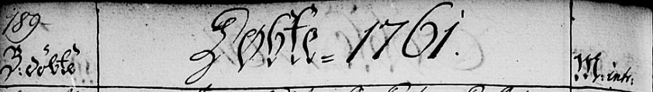
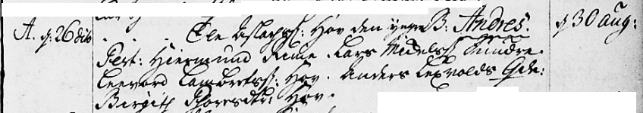
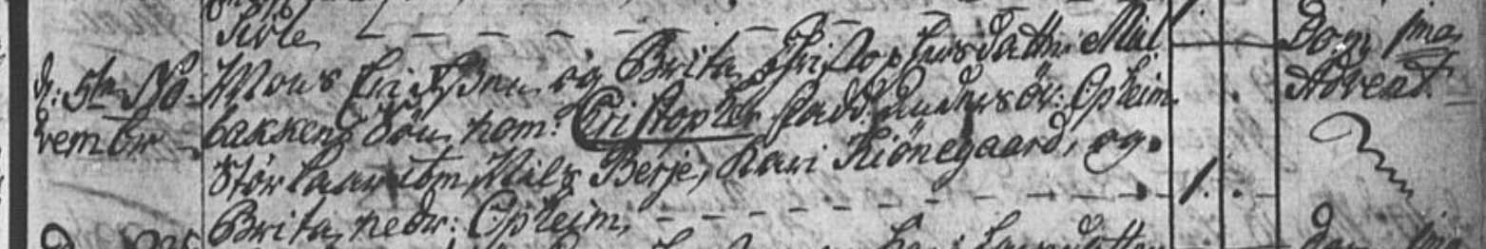
Example – Anders Olsen 1761 Link
Example – Christopher Monsen – 1774 Link
Notes:
URN:NBN:no-a1450-kb20070314650185.jpg (1963×1536) (digitalarkivet.no)
URN:NBN:no-a1450-kb20070104610224.jpg (2048×1462) (digitalarkivet.no)

Slide 15
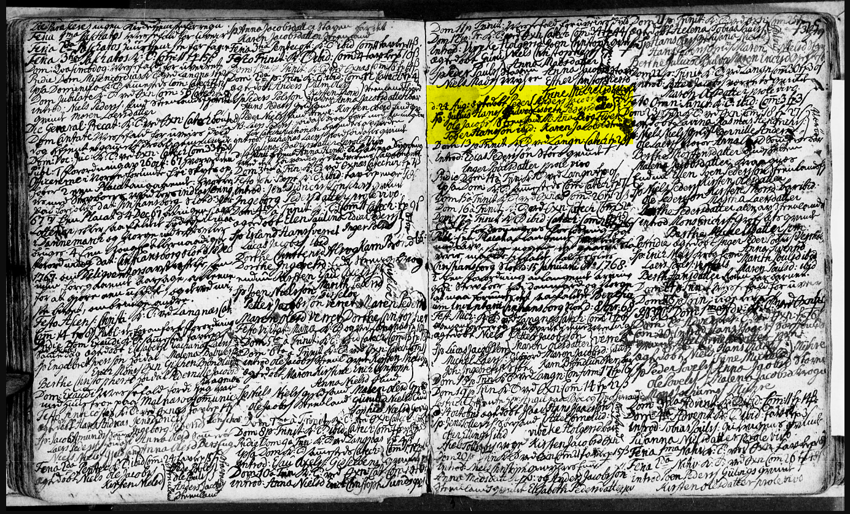
Example – Peder Andersen 1768 Link
Notes:
URN:NBN:no-a1450-kb20071108630225.jpg (2048×1253) (digitalarkivet.no)

Slide 16
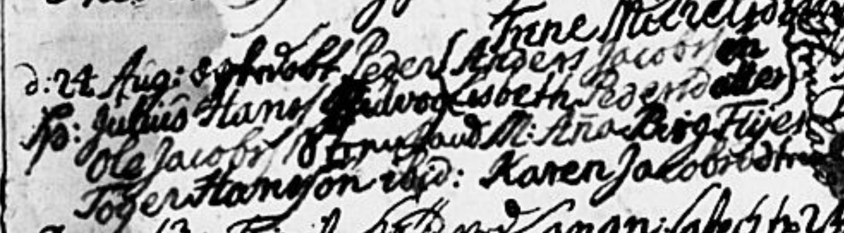
Example – Peder Andersen 1768 Link
Notes:
URN:NBN:no-a1450-kb20071108630225.jpg (2048×1253) (digitalarkivet.no)

Slide 17
Marriages generally follow the same format for most eras. However, the order can vary parish to parish.
Marriages usually start with the husband’s name followed by the wife’s.
Sometimes parents are listed after each spouse and sometimes after both. Parents may not be listed.
Ages and birthplaces are given in later records.

Slide 18
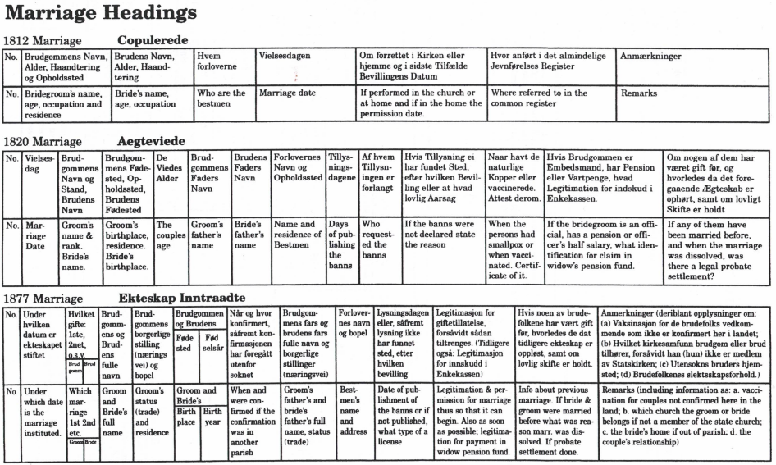
The general format is shown below.

Slide 19
The key words to look for – Troloved (Betrothed), Desponsati (Sponsorship), Copulerede (Co-habitating), Ægteviede (Marriage Vows), or Ekteskap Inntraadte (Marriage Entered Into) indicate a marriage.
Residences – farm names – and professions are often omitted.

Slide 20
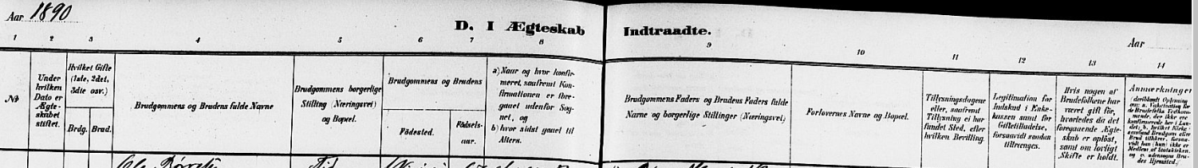
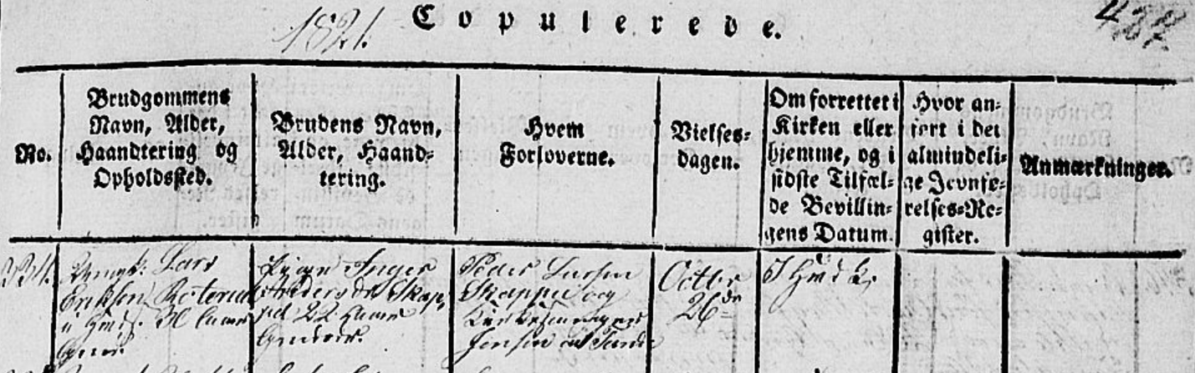
Example – Ole Andreason & Lina Jorgensdatter 1890 Link
Example – Lars Eriksen & Inger Andersdatter 1821 Link
Notes:
URN:NBN:no-a1450-kb20070110660609.jpg (1939×1536) (digitalarkivet.no)
URN:NBN:no-a1450-kb20070512960533.jpg (2048×1512) (digitalarkivet.no)

Slide 21
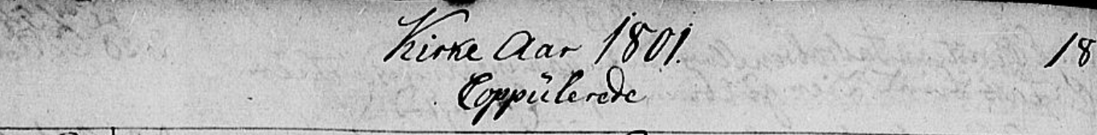
Example - Thorkild Olsen & Johanne Olsdatter 1801 Link
Example - Lars Hovelsen Mette Larsdatter 1747 Link
Notes:
URN:NBN:no-a1450-kb20070512960116.jpg (1977×1536) (digitalarkivet.no)
URN:NBN:no-a1450-kb20070512940657.jpg (1990×1536) (digitalarkivet.no)

Slide 22
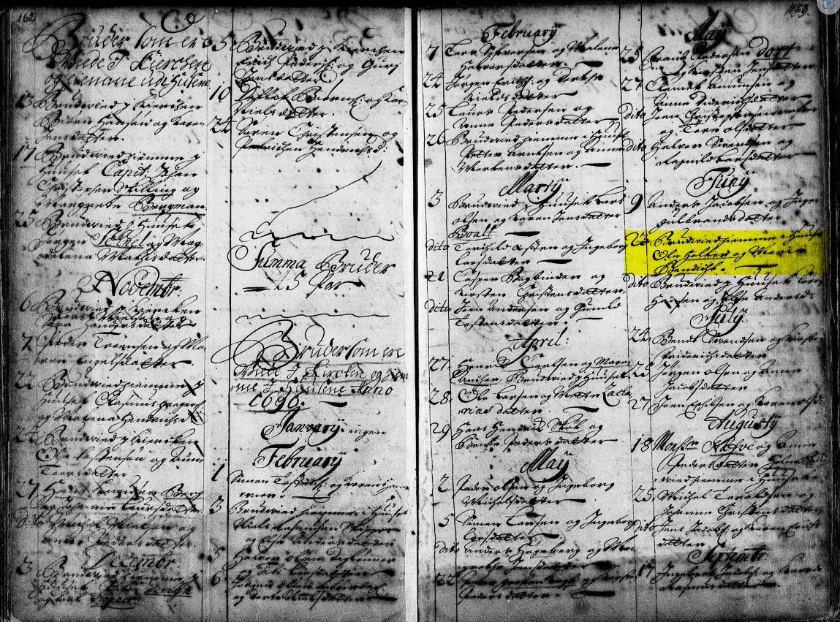
Example – Ole Jensen & Marie Jochumsdatter 1696 Link
Notes:
URN:NBN:no-a1450-kb20060217020303.jpg (2009×1536) (digitalarkivet.no)

Slide 23
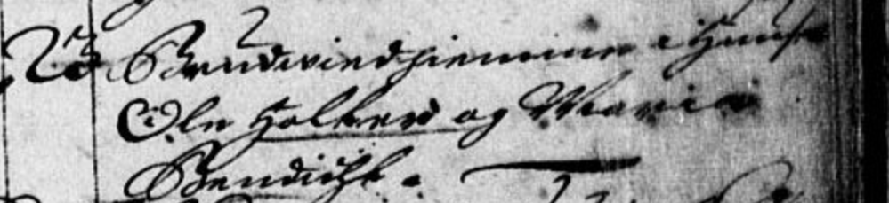
Example – Ole Jensen & Marie Jochumsdatter 1696 Link
Ole Jensen Holter Frogn and Maria Jochumsdatter Bendeke

Slide 24
Deaths carry less information as you go back, and usually disappear before 1750.
They generally follow the same format for most eras – with more information being added as they get to newer times. However, the order can vary parish to parish.
Basic Death records are the date and the person. As records get newer, age, place of death, place of birth, and relatives get added.

Slide 25
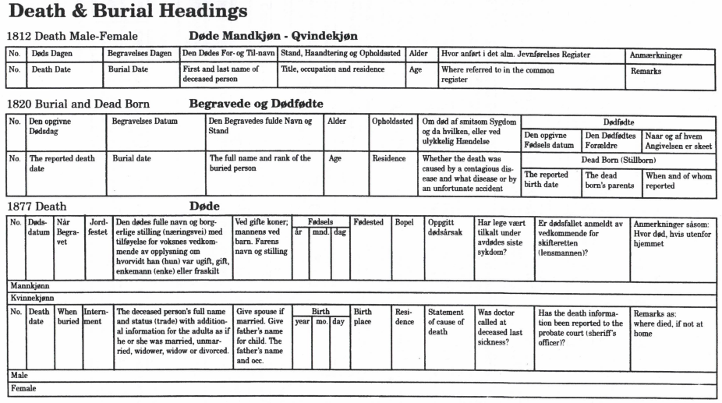
The general format is shown below.

Slide 26
The key words to look for – Døde (Died) and Begravede (buried) indicate a death or burial.
Residences – farm names – and professions are often omitted.

Slide 27
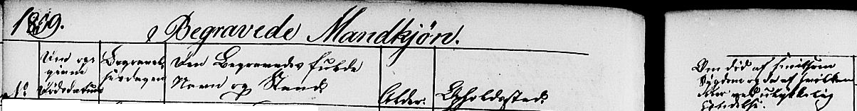
Example – Jorgen Johannesen 1880 Link
Example – Jorgen Larsen 1839 Link
Notes:
URN:NBN:no-a1450-kb20070110660616.jpg (1955×1536) (digitalarkivet.no)
URN:NBN:no-a1450-kb20070110650544.jpg (1970×1536) (digitalarkivet.no)

Slide 28
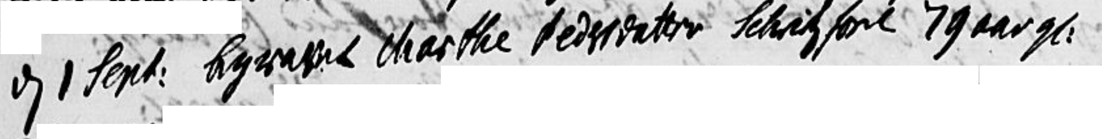
Example – Margrete Pedersdatter 1797 Link
Males Year Females
Example – Marte Pedersdatter 1738 Link
Notes:
URN:NBN:no-a1450-kb20070512950289.jpg (2048×1519) (digitalarkivet.no)
URN:NBN:no-a1450-kb20070512940483.jpg (2008×1536) (digitalarkivet.no)

Slide 29
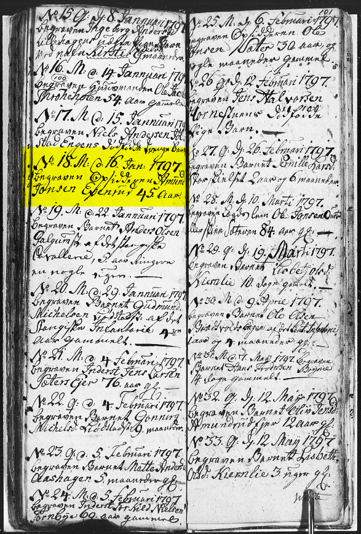
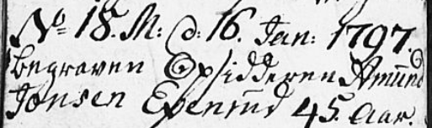
Example – Amund Jonsen
1797 Link
Notes:
URN:NBN:no-a1450-kb20070111640258.jpg (1086×1536) (digitalarkivet.no)

Slide 30
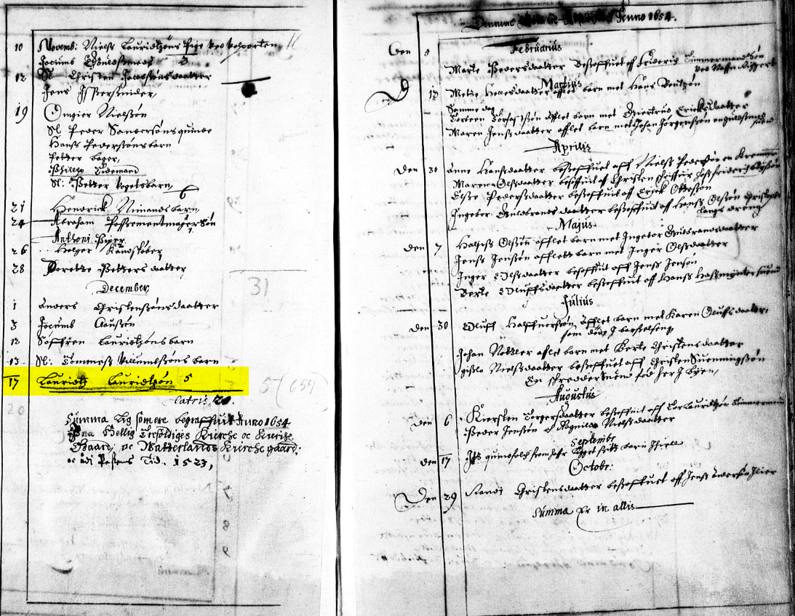

Example –
Lauritz Lauritzen
1654 Link
Notes:
URN:NBN:no-a1450-kb20060217020260.jpg (2020×1536) (digitalarkivet.no)

Slide 31
Confirmations can carry only the person and date to also including the age, birth, parents, and farm.
They generally follow no format. Even though the books show one.
The key word to look for is Confirmerede or Konfirmerte (Confirmed).
Drenge (boys) and Piger (girls) refer to the sex.

Slide 32
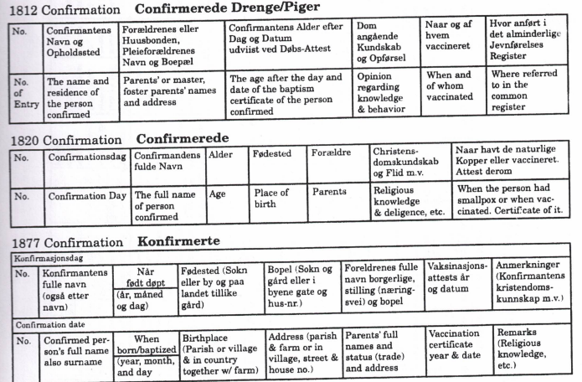
The general format is shown below.

Slide 33
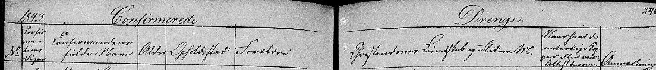
Example – Lina Jorgensdatter 1884 Link
Example – Jorgen Johannessen 1843 Link
Notes:
URN:NBN:no-a1450-kb20070110660068.jpg (1993×1536) (digitalarkivet.no)
URN:NBN:no-a1450-kb20070512980020.jpg (1857×1536) (digitalarkivet.no)

Slide 34

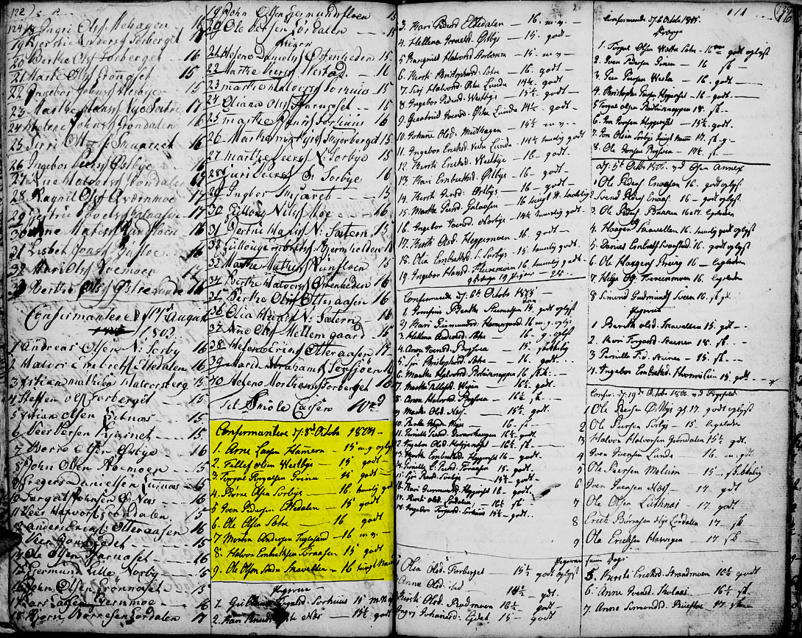
Example – Arne Larsen 1805 Link
Notes:
https://urn.digitalarkivet.no/URN:NBN:no-a1450-kb20070603320607.jpg

Slide 35
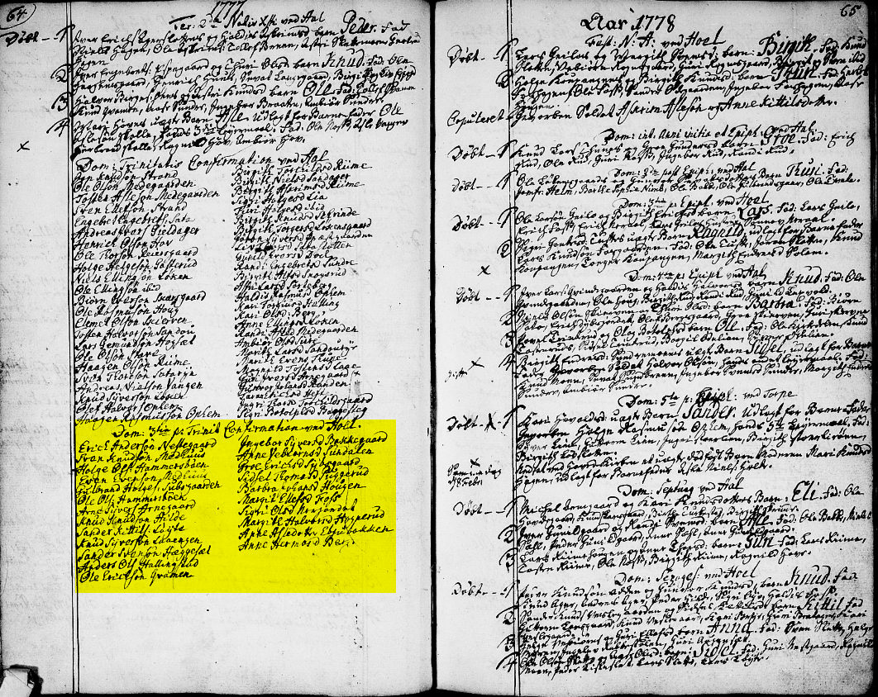

Example – Erich Andersen 1777 Link
Notes:
URN:NBN:no-a1450-kb20070314660036.jpg (1967×1536) (digitalarkivet.no)

Slide 36
References
Gothic Alphabet
http://www.hist.uib.no/gotisk/gotiskalfa.htm
An overview of the Gothic alphabet.
DigitalArkivet– Practice with Gothic Manuscript App
Apple – search store for “Gotisk håndskrift”
Android – Not on store but available at
https://m.apkpure.com/gotisk-h%C3%A5ndskrift/no.vangenplotz.gotisk/download?from=details
Gothic alphabet on own app
The app is based on the watchmaker Gunder Therkildsen in Vestre Moland's manuscript from the 1850s. Here you can type yourself on the keyboard and get it up in Gothic. It's a smart way to practice. There is also an alphabet there that gives you an overview of the different letters. In the app you will also find a dictionary with approx. 100 words with job titles and other words that often appear in church records. The app has been developed by, among others, Knut Johannessen who has written the book "Den glemte skriften".
A Research Guide for Norwegian Genealogy, Norwegian American Genealogical Center and Naeseth Library, Madison, Wisconsin, 2013
Dictionary for genealogists (in Norwegian – must use VPN to access)
https://www.nb.no/items/c819c0984271b0f7b194632d130733d2;page=0;searchText=ordbok for slektsforskere?page=0
Latin dates, words and expressions, common in church books (Translates from Norwegian to English)
http://www.innherred.net/genealogi/latin.htm
Calendar of church holidays (in Norwegian – enter year for “År”)
https://trinitatis.no/
German Church Record Vocabulary: The Most Important Words
https://germanologyunlocked.com/german-church-record-vocabulary-important-words/#:~:text=German%20Church%20Record%20Vocabulary%3A%20The%20Most%20Important%20Words,%20%20Geburt%20%2028%20more%20rows%20
Notes:
URN:NBN:no-a1450-kb20070512950185.jpg (2048×1497) (digitalarkivet.no)

Slide 37
Reading old Script from Norwegian Records Practicum 6December2025 Updated 11/30/2025 2:09 PM

